Slide 1
Updated model for PLPome map
iML1515 → “iML1515_PLP_Jun27_JTB” (→ whatever we name it)
The model is working/I can paint my data on, but it does say it can’t find one reaction in the model…

Slide 2
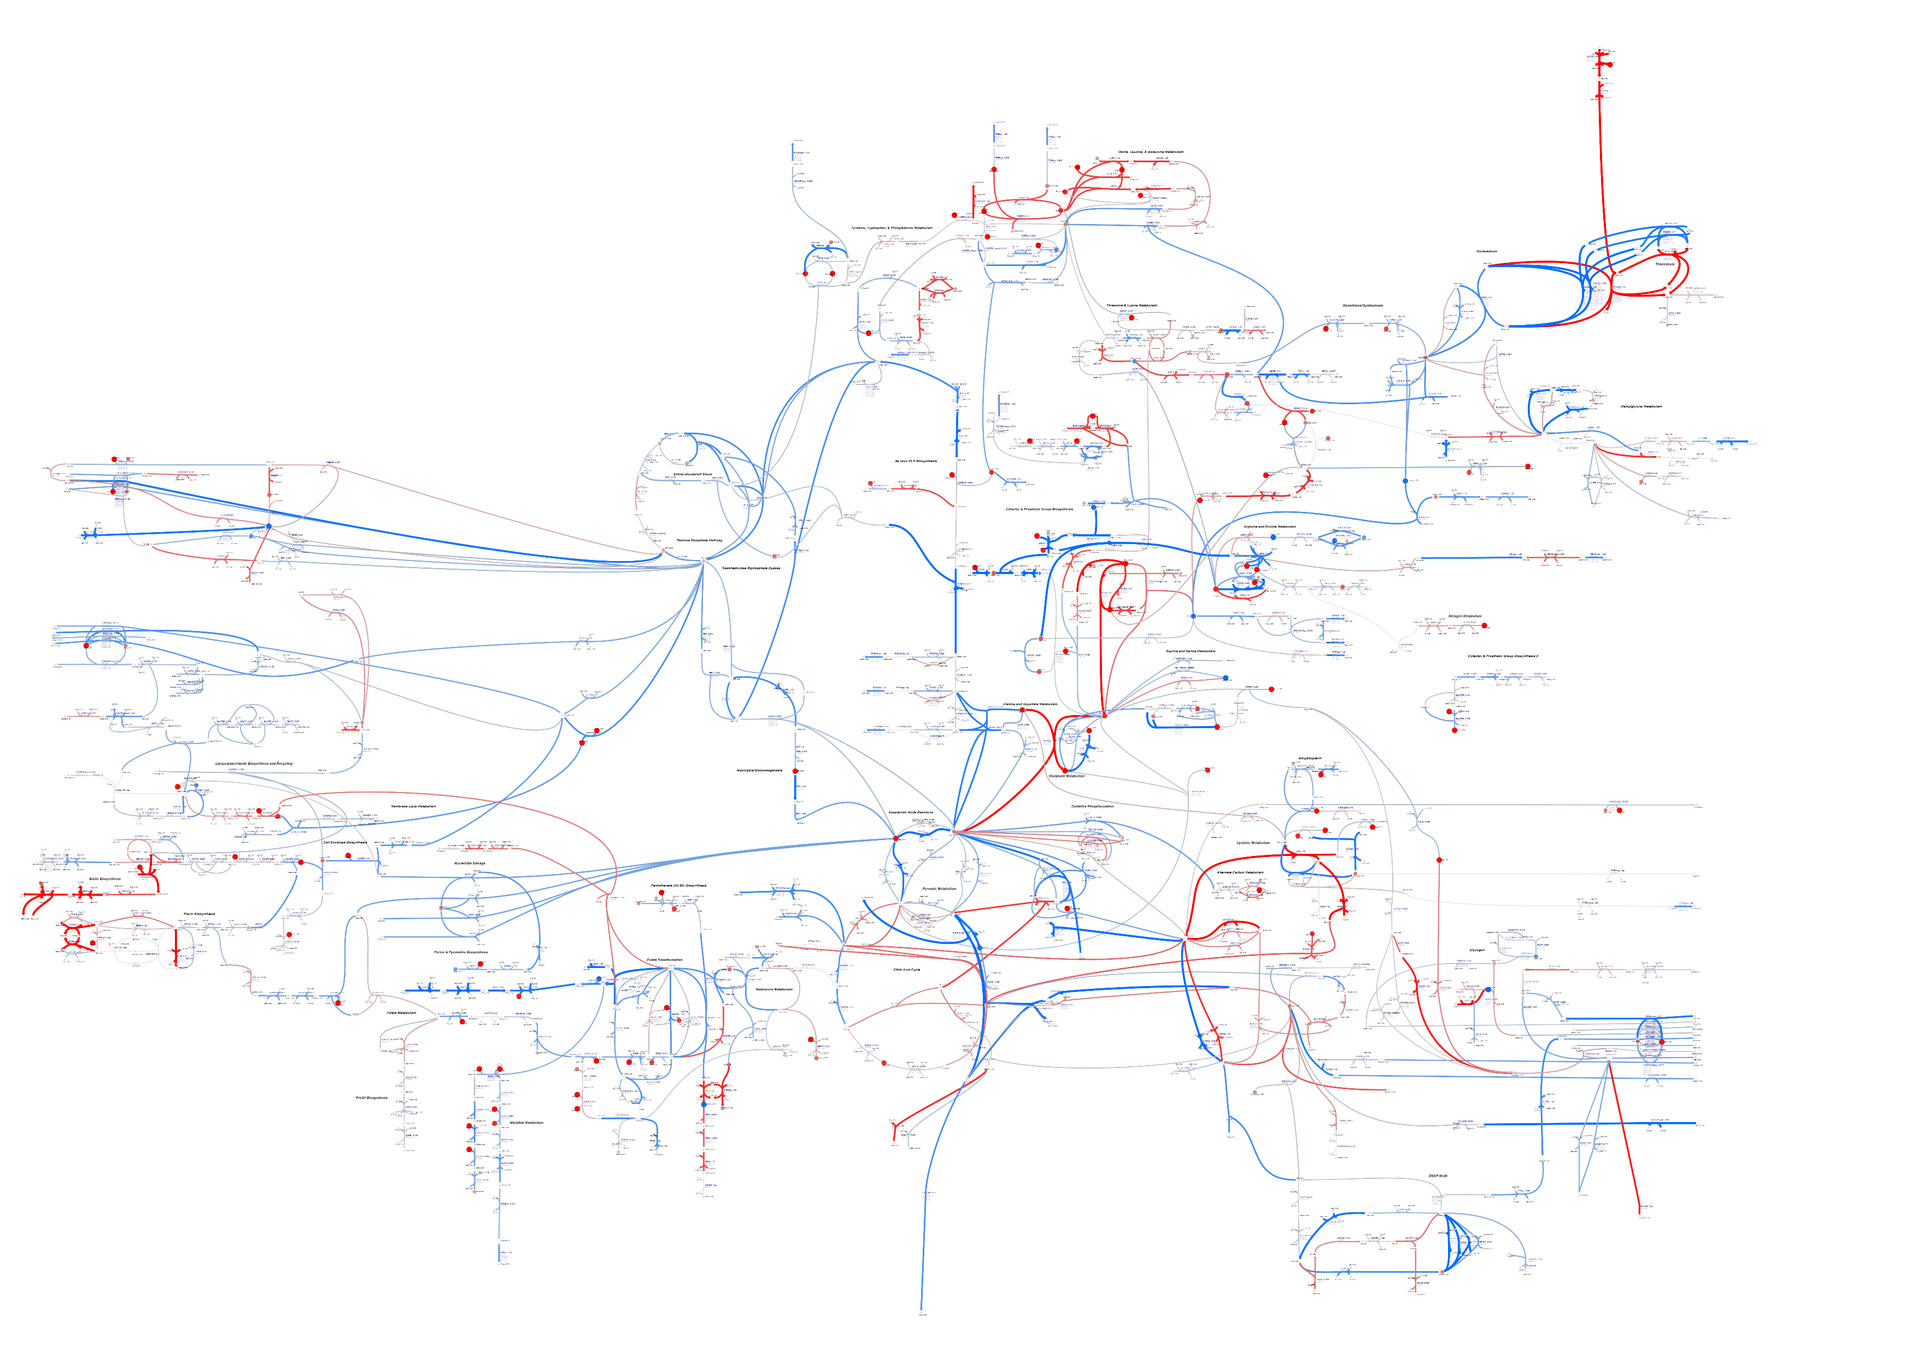
ΔpdxBJ vs WT 20nM PN log2 FC RNA-seq and metabolite concentration data
painted on “Expanded PLPome” map with “iML1515_PLP_Jun27_JTB” model

Slide 3
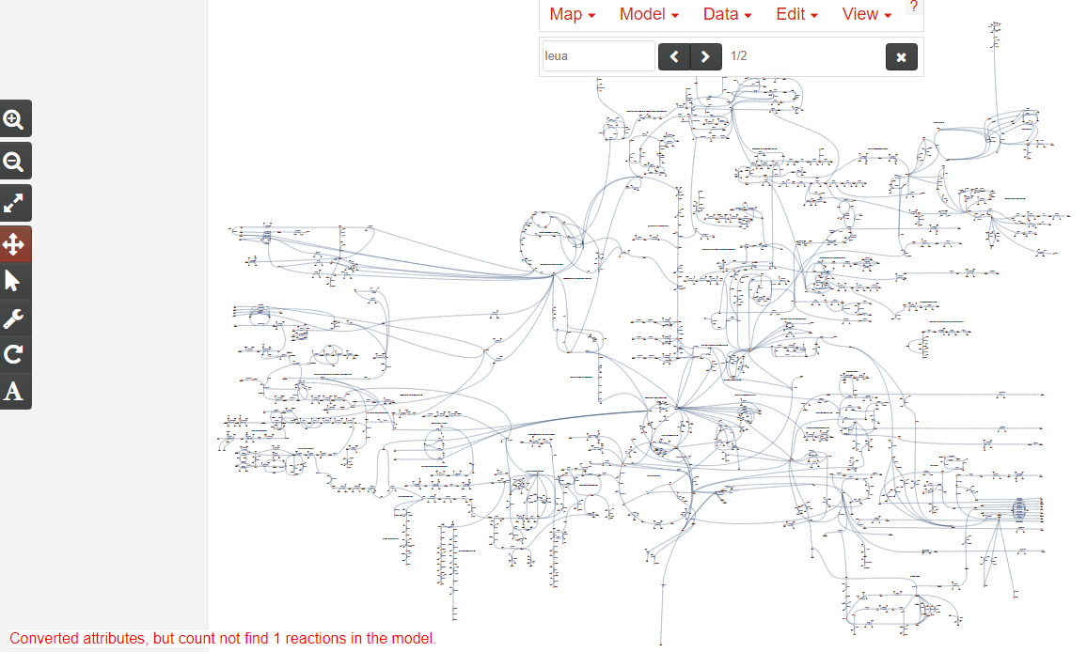
The model is working/I can paint my data on, but it does say it can’t find one reaction in the model… Chis, maybe you can see what that would be when you cross it with the original?
I should find it quickly if it’s one I need (I hope)…

